Slide 1
What is Modularity?
Definition: Breaking down a program into smaller, reusable parts.
Key Concepts:
Functions
Modules
Packages

Slide 2
Benefits of Modularity
Improves Code Readability and Maintainability
Easier to Debug and Test
Reusability of Code

Slide 3
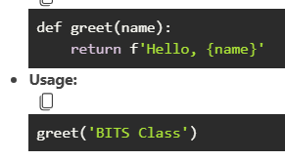
Creating Functions
Definition: A block of reusable code that performs a specific task.
Example:

Slide 4
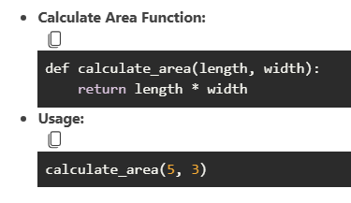
More Function Examples

Slide 5
Introduction to Modules
Definition: A file containing Python code (functions, classes, variables) that can be imported and used in other programs.
Creating a Module:
Create a file import_experiment.py
Define functions or classes inside it.

Slide 6
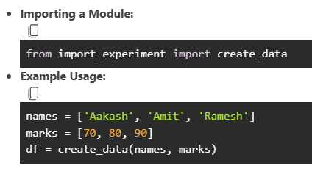
Using Modules

Slide 7
Introduction to Packages
Definition: A directory containing multiple modules and a special __init__.py file.
Creating a Package:
Create a directory utilities
Add modules like import_experiment.py and string_utils.py
Add an __init__.py file

Slide 8
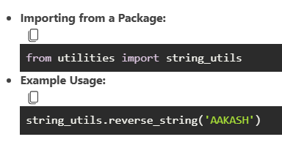
Using Packages

Slide 9
Conclusion
Summary: Modularity enhances code organization, readability, and reusability.
Encouragement: Practice creating and using functions, modules, and packages in your projects!

